Slide 1
Hardware Security
Dr. Sana Belguith

Slide 2
Rootkit

Slide 3
Purpose
Give attacker a permanent root access to a system
Hide its presence
Hide from filesystem
Hide its activity
etc…
Steal information
Allow remote code execution

Slide 4
Typical attacker steps
Initial intrusion (e.g. exploit remote execution)
Open remote access (e.g. reverse shell)
Privilege escalation (e.g. see Lecture 1)
Download the malicious payload (our rootkit)
Install rootkit
Perform malicious action on command
DDOS
Steal data
etc…

Slide 5
Kernel rootkit

Slide 6
Rootkit high-level understanding
applications
libraries
data
User space
Where what user interact with exists
operating system
Kernel space
Where hardware can be controlled
hardware

Slide 7
Rootkit high-level understanding
applications
libraries
data
User space
operating system
Kernel space
virtual layer
Where virtual machine are managed (optional)
hardware

Slide 8

Rootkit high-level understanding
applications
libraries
data
User space
operating system
Kernel space
Goal hide malicious file/process etc.
rootkit
hardware

Slide 9
Rootkit high-level understanding
applications
libraries
data
User space
ls
operating system
getdents
Kernel space
rootkit
hardware

Slide 10
Rootkit high-level understanding
applications
libraries
data
User space
ls
operating system
getdents
Kernel space
rootkit
modify returned value to exclude ../malicious/
hardware

Slide 11
Rootkit high-level understanding
Modify the behaviour of anything that could reveal malware presence, e.g.:
ls
ps
lsmod
etc…
Give an easy mean to obtain root privileges, e.g.:
modify fork behaviour
applications
libraries
data
User space
operating system
Kernel space
rootkit
hardware

Slide 12
Rootkit high-level understanding
applications
libraries
data
Roughly three techniques
Modify the kernel code;
“Hooking” modify where certain functions point to;
Modify data structure (e.g. active process list)
User space
operating system
Kernel space
rootkit
hardware

Slide 13
Types of rootkit
Application rootkit
Kernel rootkit
Virtualized rootkit
Bootloader rootkit
Hardware & firmware rootkit

Slide 14
Types of rootkit
Application rootkit
Kernel rootkit
Virtualized rootkit
Bootloader rootkit
Hardware & firmware rootkit
They can be prevented/detected by going (at least) one layer down

Slide 15
Trusted Computing Base

Slide 16
Trusted Computing Base (TCB)
What part of the system do I need to trust in order to achieve my objective
Application

Slide 17

Trusted Computing Base (TCB)
What part of the system do I need to trust in order to achieve my objective
Application

Slide 18
Trusted Computing Base (TCB)
What part of the system do I need to trust in order to achieve my objective
Application
Application
Application

Slide 19
Trusted Computing Base (TCB)
What part of the system do I need to trust in order to achieve my objective
Application
Application
Application
Operating System

Slide 20
Trusted Computing Base (TCB)
What part of the system do I need to trust in order to achieve my objective
Application
Application
Application
Operating System

Slide 21
Trusted Computing Base (TCB)
What part of the system do I need to trust in order to achieve my objective
Application
Application
Application
Operating System
Hardware

Slide 22
Trusted Computing Base (TCB)
What part of the system do I need to trust in order to achieve my objective
Application
Hardware

Slide 23
Trusted Platform Module

Slide 24
TPM (Trusted Platform Module)
Trusted Computing Group
Microsoft, Intel, IBM etc…
Promoting standard for more trusted computing
Additional chip on the motherboard
… called TPM
Used for
Disk encryption
System Integrity
Password protection
… and more

Slide 25
Requirements
We can achieve trust if we can verify the system has booted correctly
We assume the PC hardware has not been modified
Key function is in the hardware TPM
We need to monitor the boot process
Initial boot measure by the “Core Root of Trust” (CRTM)
Hash the BIOS, store results in TPM, start the BIOS
BIOS do its job, load the next stage, hash it store in TPM etc…
Core Root of Trust :The first piece of BIOS code that executes on the main processor during the boot process. On a system with a Trusted Platform Module the CRTM is implicitly trusted to bootstrap the process of building a measurement chain for subsequent attestation of other firmware and software that is executed on the computer system.

Slide 26
Authenticated Boot
CRTM - BIOS
TPM

Slide 27
Authenticated Boot
Hash
CRTM - BIOS
BIOS
Report hash
TPM

Slide 28
Authenticated Boot
Hash
CRTM - BIOS
BIOS
Hand-off
Report hash
TPM

Slide 29
Authenticated Boot
Hash
Hash
CRTM - BIOS
BIOS
OS Loader (e.g. GRUB)
Hand-off
Report hash
Report hash
TPM

Slide 30
Authenticated Boot
Hash
Hash
CRTM - BIOS
BIOS
OS Loader (e.g. GRUB)
Hand-off
Hand-off
Report hash
Report hash
TPM

Slide 31
Authenticated Boot
Hash
Hash
Hash
CRTM - BIOS
BIOS
OS Loader (e.g. GRUB)
OS
Hand-off
Hand-off
Report hash
Report hash
TPM
Report hash

Slide 32
Authenticated Boot (simplified)
Hash
Hash
Hash
CRTM - BIOS
BIOS
OS Loader (e.g. GRUB)
OS
Hand-off
Hand-off
Report hash
Report hash
TPM
Report hash

Slide 33
TPM registers
Platform configuration registers (PCRs)
Used to store platform integrity metrics
A PCR hold a summary of a series of value
Not the entire chain of hash
The chain can be infinite
A PCR register is extended
PCR = HASH(PCR | new measurement)
Shielded TPM location (i.e. cannot be modified from outside)
Measurement are provided by software

Slide 34
Remote attestation
Untrusted prover “P” and trusted verifier V
V knows P expected memory content
V send challenge with a nonce to P
P compute a measurement
V verify the measurement
V
Challenge
P
H(Challenge, Memory)

Slide 35
What remote attestation tells you
Positive result
Correct memory content
Good device
Negative result
Malfunctioning device
Malicious device
No response
Malfunctioning device
Malicious device

Slide 36
TPM and Remote Attestation
PCR cannot be modified
Only reset at reboot
TPM contains a key used to sign the attestation
Verifier
Verify the TPM certificate/key
Verify the PCRs
Attestation
PCRs value
sign(PCRs, challenge[nonce])

Slide 37
TPM and Remote Attestation
You need not to stop at the OS
Can attest kernel modules (e.g. drivers)
Applications?
Configurations?
Scripts?
Where to stop?
Problem with load order? (remember it is a chain)

Slide 38
Intel SGX

Slide 39
Rootkit high-level understanding
applications
libraries
data
User space
operating system
Kernel space
bad code
hardware

Slide 40
Motivation
An attacker can compromise
User space
Operating Systems
Even the hardware!
What can we do?
Execute code in its own secure enclave!

Slide 41
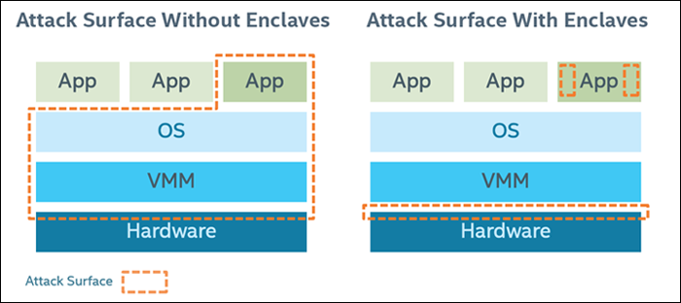
SGX Hardware supported enclave
Idea: run an application within some isolation unit so it cannot be affected by the OS
Do not trust the OS or the VMM/hypervisor
only need to trust the hardware
reduce attack surface

Slide 42
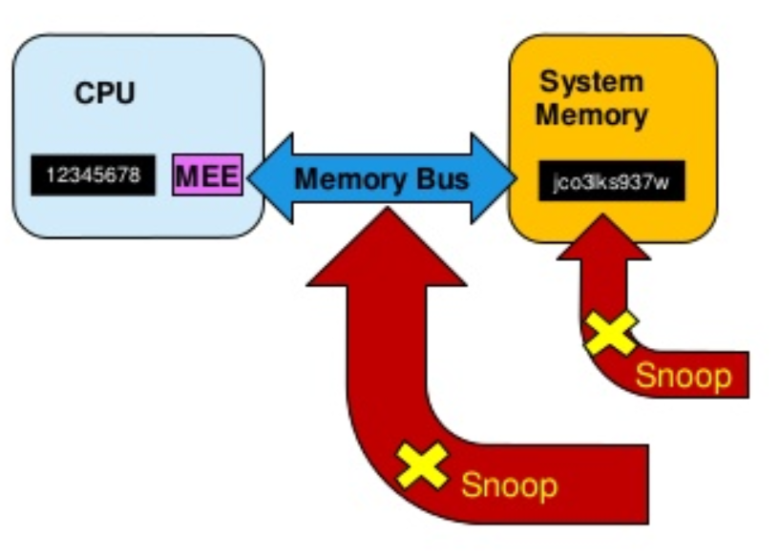
SGX preventing memory snooping attack
* MEE: SGX Memory Encryption Engine
Security boundary is CPU package
Data unencrypted inside the CPU
Data outside the CPU is encrypted
External memory reads and bus snooping only see encrypted data

Slide 43
SGX Programming environment
OS
Enclave Stack
Enclave has its own code and data
Provide confidentiality
Provide integrity
Controlled entry point
Can enter enclave code only at specific point
Enclave execution takes over
Enclave Heap
Enclave
Enclave Code
App Data
App Code
User Process

Slide 44
SGX Application Flow
Call Bridge
Define and partition application into trusted and untrusted part
App create enclave
Trusted function is called
Code in enclave process some secret
Trusted function returns
App continue as normal
2. Create Enclave 3. Trusted() 6. Continue
4. Process Secret 5. Return

Slide 45
ARM Trustzone

Slide 46
ARM Trustzone
Untrusted
Trusted
Application
Application
Application
Trusted Application
Trusted Application

Slide 47
ARM Trustzone
Untrusted
Trusted
Application
Application
Application
Trusted Application
Trusted Application
OS
Secure OS

Slide 48
ARM Trustzone
Untrusted
Trusted
Application
Application
Application
Trusted Application
Trusted Application
Own processor Own RAM address
Own devices
etc…
OS
Secure OS
Secure Monitor

Slide 49
ARM Trustzone
Untrusted
Trusted
Android App
Android App
Android App
Trusted Application
Trusted Application
TrustyLib
TrustyLib
TrustyLib
TrustyLib
TrustyLib
Android OS
Trusty OS
Trusty Driver
Secure Monitor
Trusty Dispatcher

Slide 50
ARM Trustzone
Trusted IPC
Untrusted
Trusted
Android App
Android App
Android App
Trusted Application
Trusted Application
TrustyLib
TrustyLib
TrustyLib
TrustyLib
TrustyLib
Android OS
Trusty OS
Trusty Driver
Secure Monitor
Trusty Dispatcher

Slide 51
Trusted IPC example
connect(path, flags)
send_msg(handle, msg)
get_msg(handle, *msg_info)
read_msg(handle, id, offset, *msg)
Trusted service declare endpoints
Untrusted apps can connect and exchange with trusted apps
Occur through driver + secure monitor

Slide 52
ARM Trustzone
Examples:
Digital Right management
Secure banking
Multi-factor authentication
etc…
Untrusted
Trusted
Android App
Android App
Android App
Trusted Application
Trusted Application
TrustyLib
TrustyLib
TrustyLib
TrustyLib
TrustyLib
Android OS
Trusty OS
Trusty Driver
Secure Monitor
Trusty Dispatcher

